Slide 1
MANAGEMENT OF HAZARDOUS WASTES:
PERCEPTIONS ON COMPLIANCE OF
THE SUPREME COURT ORDER, 14.10.2003
(in the matter of Write Petition [C] No. 657 of 1995)
Presentation by
Dr. Dilip B. Boralkar
At
Environment Management Center, Mumbai
July, 16th, 2011

Slide 2
Introduction
SC Order, 14.10.2003 accepted grim reality of non-compliance of HW Rules in the country
Realized adverse effects of indiscriminate dumping of HW in India imported from developed countries
SC had constituted High Powered Committee with Prof. MGK Menon, FRS, as its Chairman in 1997
Menon Committee submitted report in Feb, 2002
Taking Cognizance of Menon Committee report, SC passed order, 14.10.2003 & set up SCMC under Chairmanship of Dr. G. Thyagarajan

Slide 3
Principal issues in WP, 657 / 1995
Concerned about dumping of HW by industrialized countries in India
Contraventions of the provisions in Basel Convention
Lack of implementation of HW Rules in India, in terms of no. of units, quantity & quality of HW
Infrastructure for management of HW (CHW TSDF)
Institutional capacity
Application of LNWT / WM
Strengthening of borders

Slide 4
ToR of Menon Committee
Basel Convention implementation
Handling of HW imported for recycling
Safeguards in place
Changes required in HW Rules
Adequacy of facilities for ESM of HW
Pre-requisites for authorization

Slide 5
ToR of Menon Committee
Criteria for designation of areas for locating HW units
Procedures for grant of authorizations by SPCB
Mechanism for publication of inventory
Framework for reducing risks to environment and public health
Mechanism for safe disposal or re-export of HW lying at Ports in India
Decontamination of ships before braking

Slide 6
Important Findings of Menon Committee
Management of indigenously generated HW : Closure of units, WM, changes in statute, SLF, Inventory, public information, rehabilitation, monitoring, etc.
Import of HW : facilities at custom, MARPOL, obligations, Basel Convention, etc.
Institutional capacity building
Amendments required in laws
Policy issues on HWM and worker’s health

Slide 7
Acceptance of Recommendations of Menon Committee
The SC Accepted recommendations made by the Menon Committee & issued order dated 14.10.2003
The SC formed 10-member Committee for monitoring of compliance of its order and report quarterly. The Committee called as Supreme Court Monitoring Committee (SCMC), chaired by Dr. G. Thyagarajan
Committee had two nominees of the SC namely Dr. Claude Alvares and Dr. D.B. Boralkar
The SCMC submitted its report in November, 2006 and Dr. Claude Alvares and Dr. D.B. Boralkar submitted their report in March, 2007.

Slide 8
Functioning of the SCMC
19 meetings across the country with focus on field visits
Consultation with public and HW generators
Special meeting with all SPCBs, CPCB and MoEF
Categorisation of States/UTs (> 100000, 1000-100000, and < 1000)
Sub Committees of SCMC
Local Area Environment Committees (LAECs)

Slide 9
Impact of SC Order
Significant changes on the ground for better. Situation changed from “very grim” to “quite good/happy”
Change in the approach of enforcement and amendments in regulation in 2003 and there after.
Increased compliance (almost 95% +)
Setting up of CHWTSDF and also CETPs up-gradation
Removal and safe disposal of HW lying in industrial estates and illegal dumps sites
Reduction in illegal imports of HW

Slide 10
Impact of SC Order
Removal and safe disposal of HW lying at Ports, Polluters Pays Principle
Public information and toxic release inventory
Preparation of guidelines and manuals for management of HW
Levy of fines and supply of drinking water to affected people
Action plan for rehabilitation/remediation of contaminated sites
Institutional capacity building initiated

Slide 11
Part II
The Court’s directions in its order dated 14.10.2003, and their implementation

Slide 12
Directions regarding domestic HW
(i): National Inventory
National inventory nearly completed
State level inventories completed by 24 SPCBs and 3 PCCs. Checked by CPCB
4 SPCBs reported no HW generating units
Delhi Pollution Control Committee was yet to submit inventory till March, 2007
4.82 Million MT of HW generated in India by 29544 units
Maharashtra & Gujarat generated 1.4 & 1.4 MMT HW/year respectively.

Slide 13
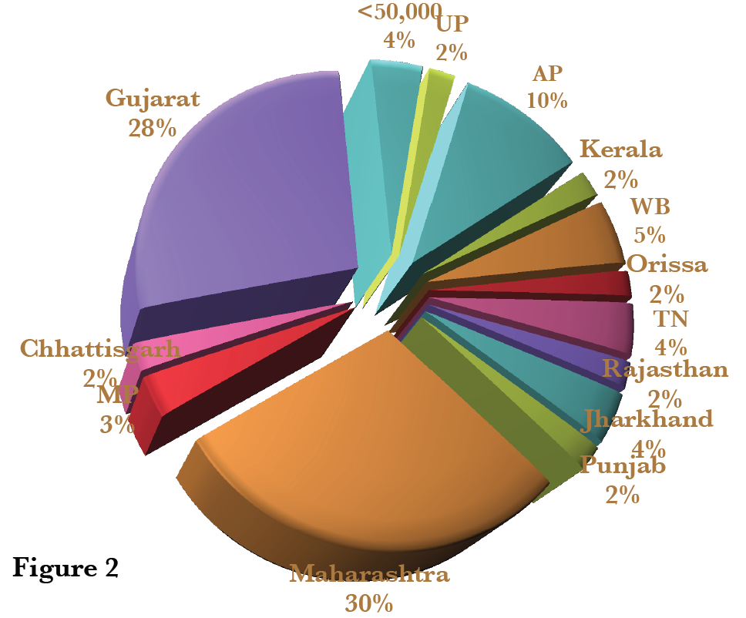
Directions regarding domestic HW
(i): National Inventory

Slide 14
Directions regarding domestic HW
(ii): Display of National Inventories in media/ website
Maharashtra, Andhra Pradesh and Gujarat maintained information on website
MPCB developed software for tracking of HW in State
Many SPCBs either do not have sites or where they do, not maintained or updated

Slide 15
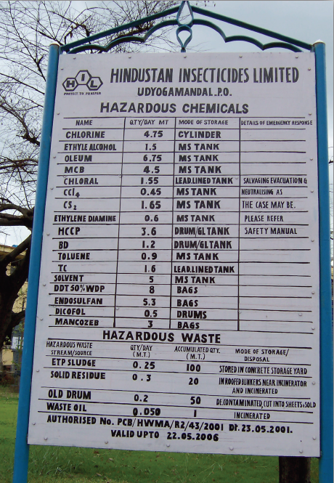
Directions regarding domestic HW
(iii): Display of information by HW generating units on boards at gates & involvement of local community in environment protection (LAEC)
Successful compliance in major States.
Apex Court direction is unprecedented and has opened up access to information about potentially hazardous industries for members of surrounding communities
LAEC : Tarapur, Kerala, Tamilnadu, Delhi, AP

Slide 16
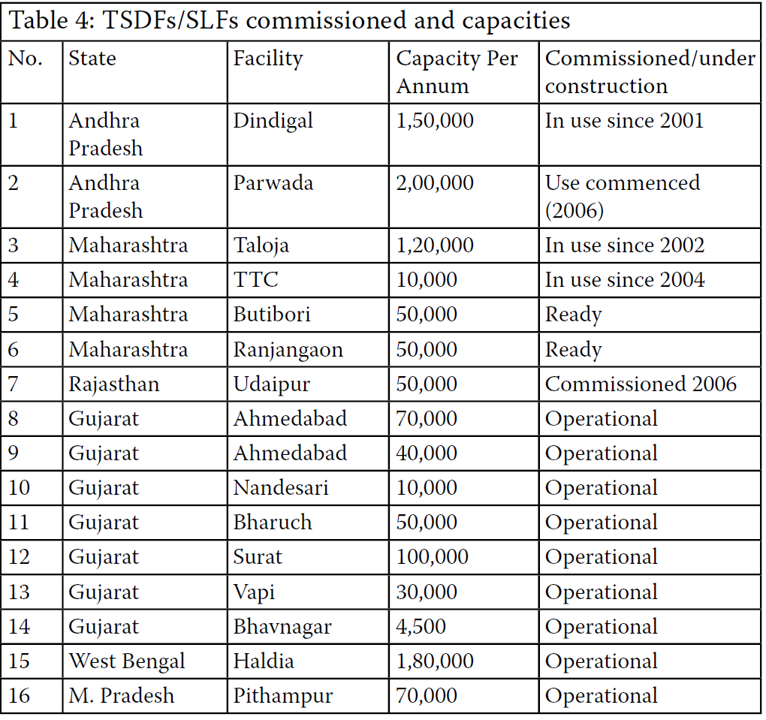
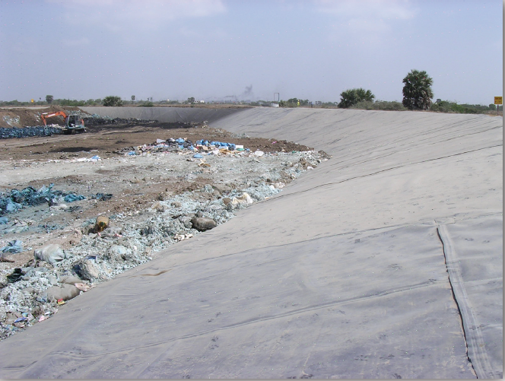
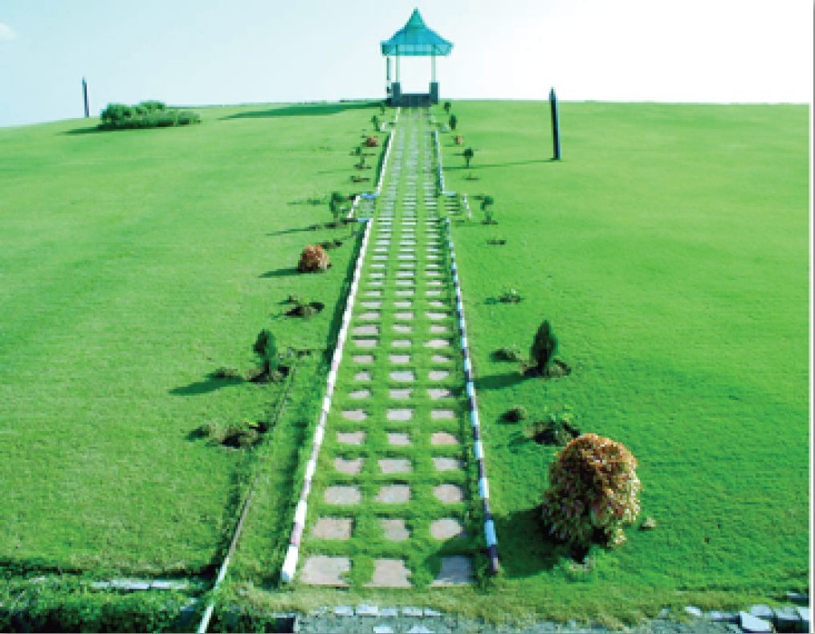
Directions regarding domestic HW
(iv): CHW TSDF

Slide 17
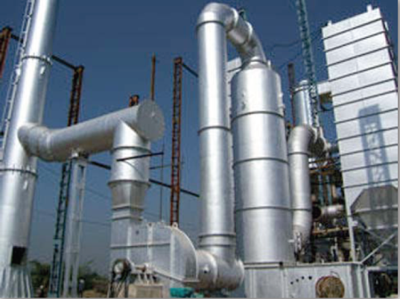
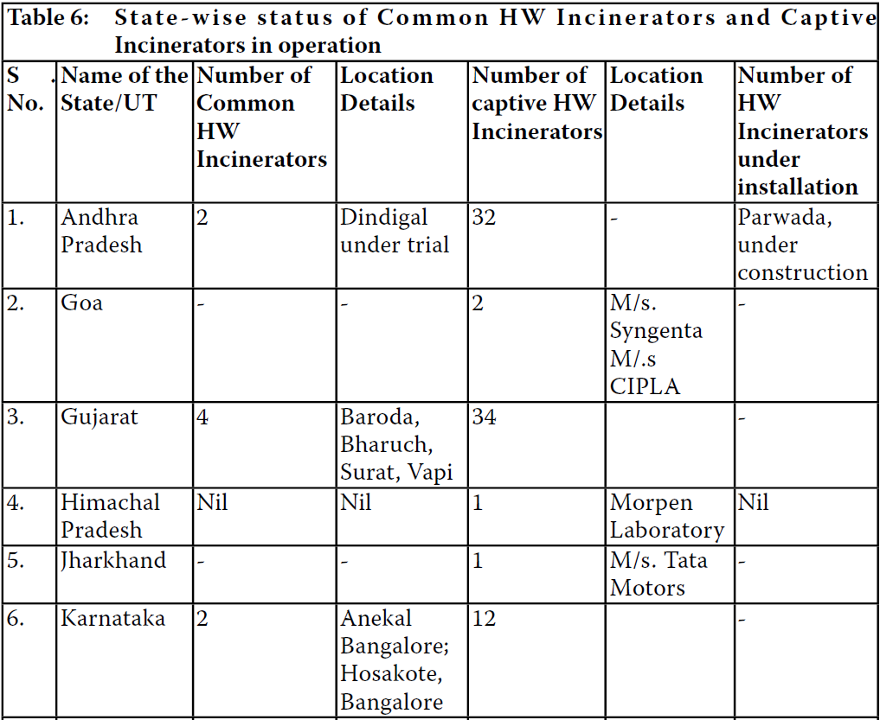
Directions regarding domestic HW
(v): HW incinerators and guidelines
Guidelines prepared & on display at CPCB website

Slide 18
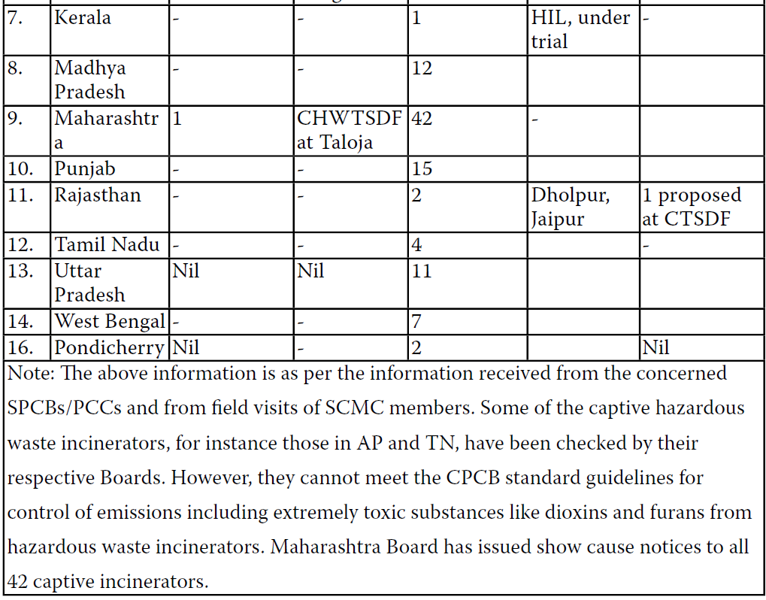
Directions regarding domestic HW
(v): HW incinerators and guidelines

Slide 19
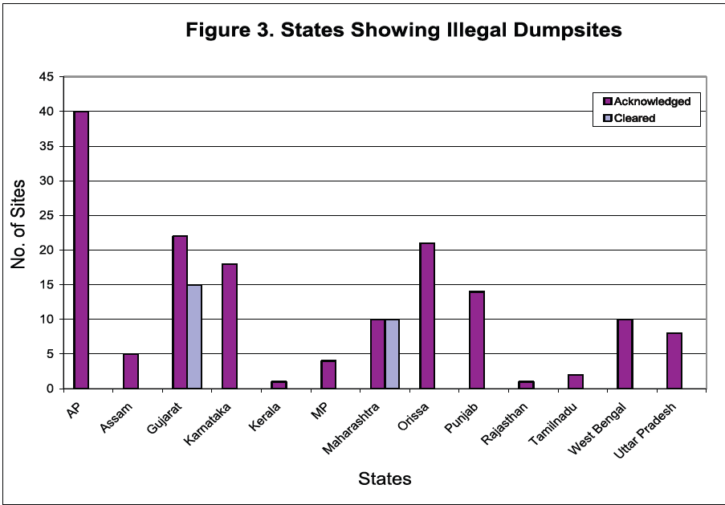
Directions regarding domestic HW
(vi): National Inventory of illlegal HW dump sites
The Court was seriously concerned with the several illlegal HW dump sites and their impact on heath & environment

Slide 20
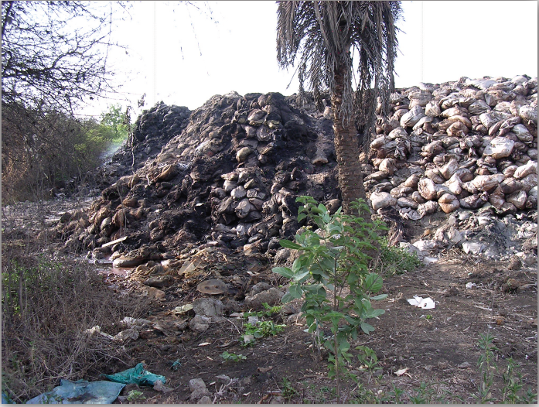
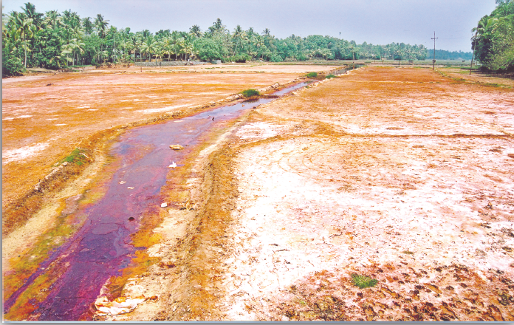
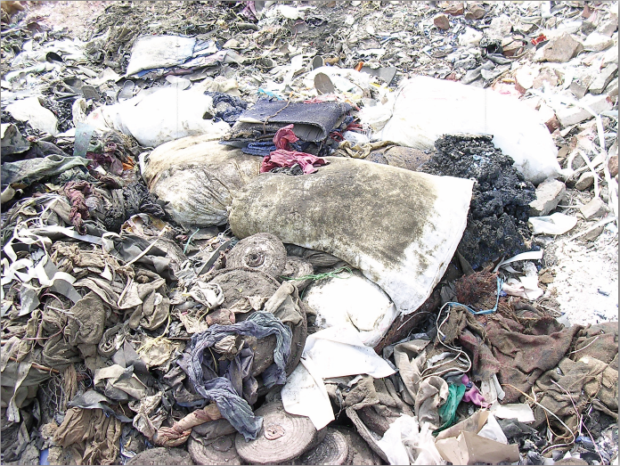
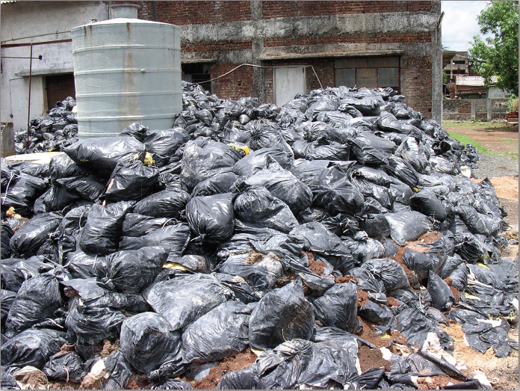
Directions regarding domestic HW
(vi): National Inventory of illlegal HW dump sites
Tarapur
Kerala
Delhi
Tarapur

Slide 21
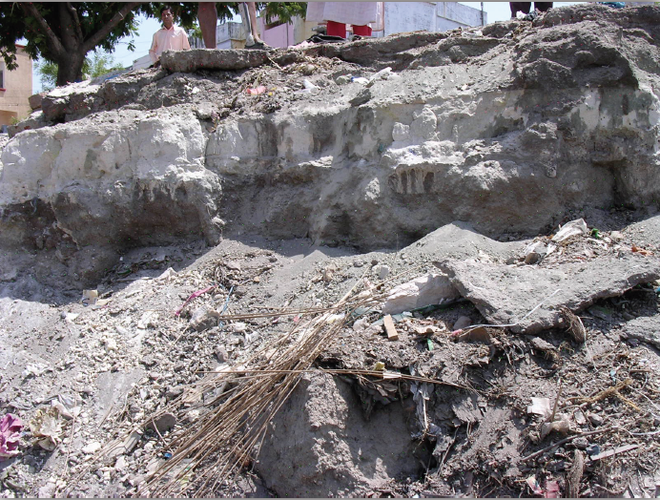
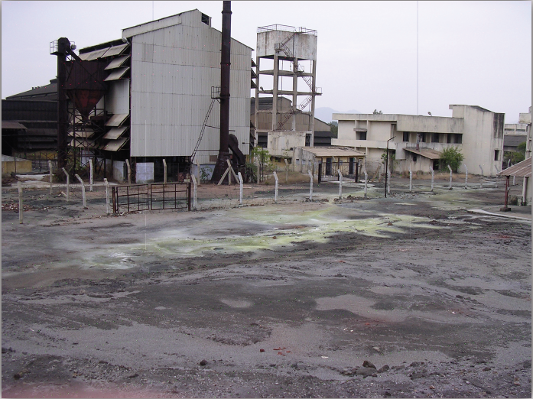
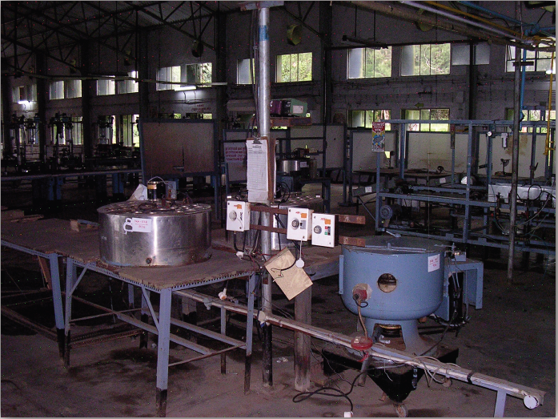
Directions regarding domestic HW
(vi): National Inventory of illlegal HW dump sites
Major Problem HW dumping sites needing special attention
Hema Chemicals - Vadodara
Tamilnadu Chromates & Chemicals - Ranipet
The SCMC was not able to inventorise or get inventorise HW lying abandoned in units that are permanently closed or are under Court receivers in different parts of country
Hindutsan Lever–mercury contamination–Kodaikanal

Slide 22
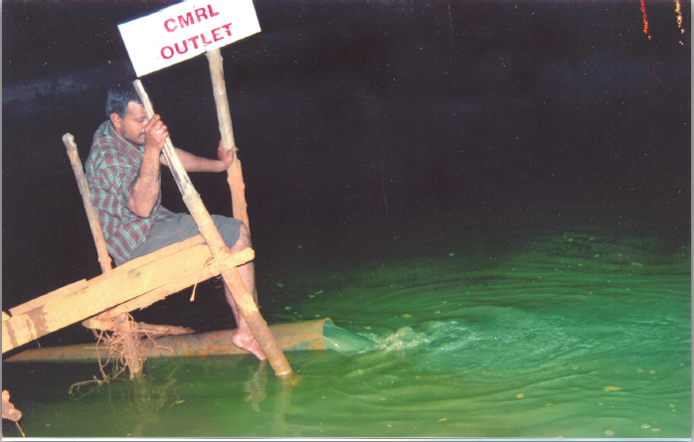
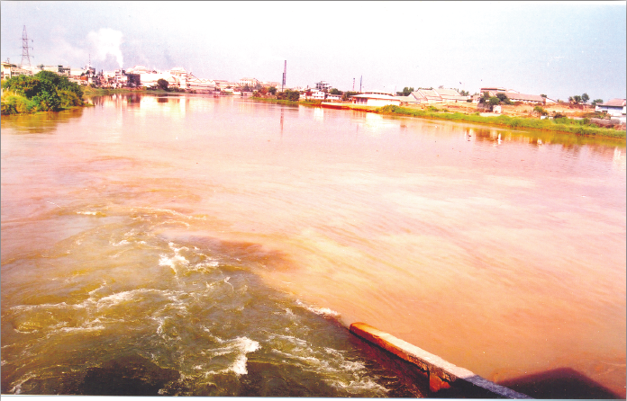
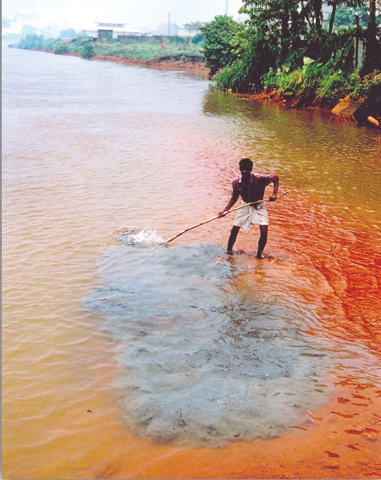
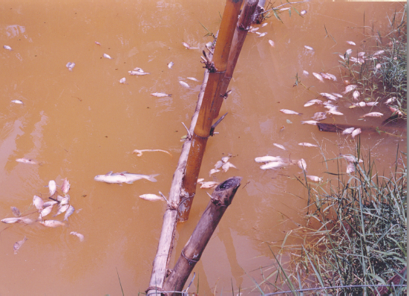
Directions regarding domestic HW
(vi): National Inventory of illlegal HW dump sites
Clean – up of river bed and restoration of life in Periyar river
Discherge of CMRL in Priyar
Priyar River
Fish kill due to toxic effluents in Periyar River, some highly acidic. (Left) a villager demonstrates bluish industrial HW sediments on the river bed which form a cloud on being disturbed

Slide 23
Directions regarding domestic HW
(vi): National Inventory of illlegal HW dump sites
Clean – up of river bed and restoration of life in Periyar river
SCMC brought entire industrial estate to heel
Fined Rs. 2.5 Cr to 247 units to set aside money for rehabilitation of the river. SCMC set up LAEC
Board closed down several industries in coordination with LAEC
Discovered clandestine discharges at night
Undiscovered more than 60 illegal outlets
After a year of these actions pH of the river improved (5-5.5) from a low of 2 (highly acidic)
Representative of fishing community met SCMC to thank the SC for restoring condition of the river and for bringing the fish back into the water body.
At the time of filing report, certain actions still remain to be completed (eg – removal of s3ediment from the river bed)

Slide 24
Directions regarding domestic HW
(vi): National Inventory of illlegal HW dump sites
Polluting industries discharging HW in lakes were ordered to shut. 60 units ordered to move out of the area
State Govt. hired consultants for rehabilitation of Katedan lake
Notice Inviting Tenders issued for construction of STP within one year so as to stop sewage discharge in the lake
AP Board reported remarkable reversal of the processes affecting the lake due to complete cessation of HW entering water body
CM of AP insisted that rehabilitation of lakes in and around Hyderabad be covered in two years

Slide 25
Directions regarding domestic HW
(vi): National Inventory of illlegal HW dump sites
Burial of Arsenic waste at Zuari Industries, Goa
Industry was directed to treat and dispose about 450 MT of Arsenic waste in “hermit storage”. Work is completed at the cost of Rs. 70 lacs.
Recommended levy of fine of Rs. 10 lacs for not taking timely steps as per SC Order of 14.10.2003
The “hermit storage” technique of encapsulating the HW was later adopted by SPIC in Tuticorin and others

Slide 26
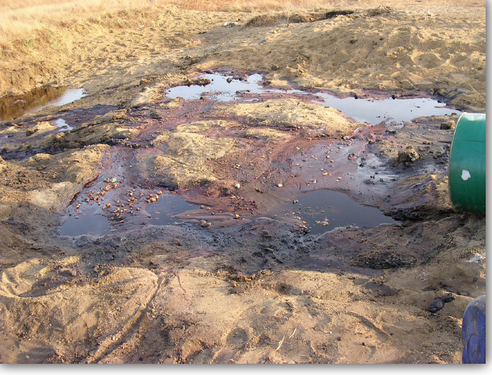
Directions regarding domestic HW
(vi): National Inventory of illlegal HW dump sites:
Case of HW dumping by Aventis Pharma in Gujarat
Industry was found discharging HW in agricultural fields. SCMC filed FIR and GPCB ensured closure of the unit.
Rs.25 lacs BG was taken for remediation. Remediation is completed to satisfaction of GPCB
This incident had led to the GPCB recalling and reviewing hundreds of such authorisations and tightening the controls over the movement & disposal of HW.
SCMC travelling through Gujarat was horrified to be taken to these agricultural fields while dumping of extremely toxic solvents was in progress.

Slide 27
Directions regarding domestic HW
(vi): National Inventory of illlegal HW dump sites:
Case of Volatile Organic Compounds
In Cuddalore industrial estate (TN) the VOCs were found being discharged into open environment by several industries.
SCMC asked CPCB to evolve necessary standards. This is done now.
Many of the VOCs found in the atmosphere of Cuddalore were found carcinogenic.

Slide 28
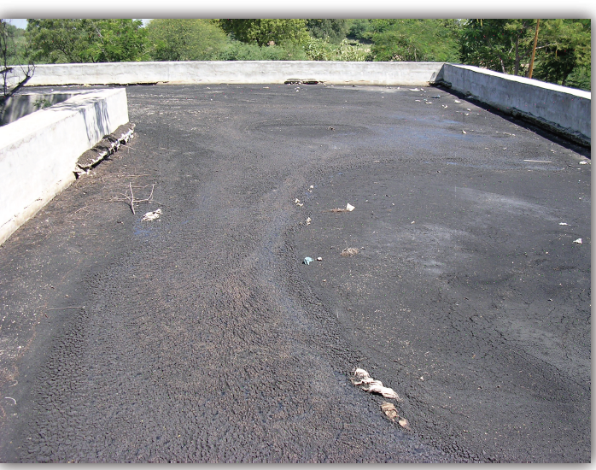
Directions regarding domestic HW
(vi): National Inventory of illlegal HW dump sites:
Improvements in CETPs w.r.t HW
23 MLD CETP at the cost of Rs. 18 Cr. completed at Tarapur
10 MLD CETP at the cost of Rs. 7.26 Cr completed with six months at Buti Bori, Nagpur
HW Sludge from CETP at Patancharu and Jeedimetla was sent to TSDF.
Delhi faces a piquant situation. It has CETPs but no TSDF.
SCMC asked SPCBs to tighten the CETP effluent standards and see that HW does not get in to it.
SCMC found huge quantities of sludge accumulated
by Patancheru and Jeedimetla CETPs.

Slide 29
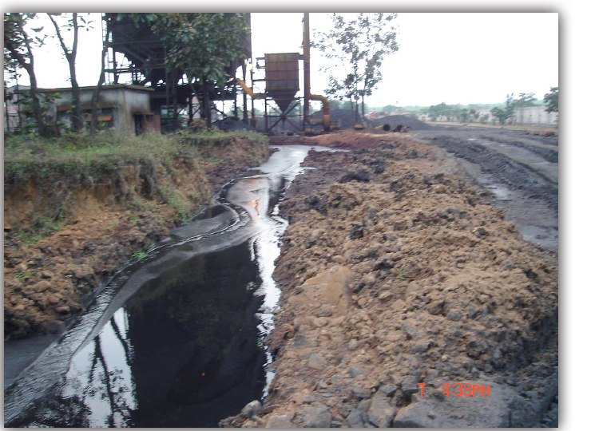
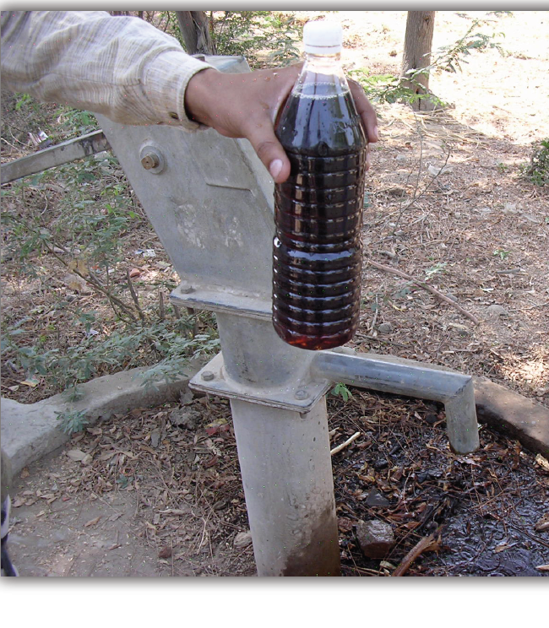
Directions regarding domestic HW
(vi): National Inventory of illegal HW dump sites:
Rehabilitation of contaminated ground water aquifers
SCMC is acutely anxious that in several areas, ground water has been rendered unpotable
There is threat to public health due to the contamination from HW leaching their toxins into soil

Slide 30
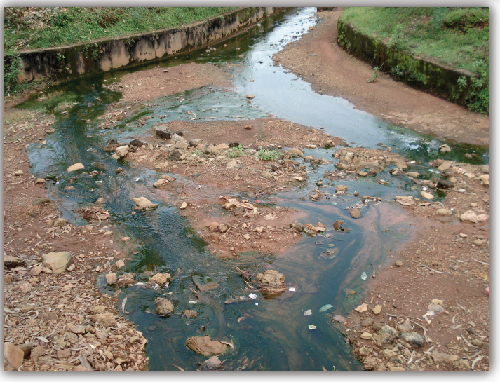
Directions regarding domestic HW
(vi): National Inventory of illegal HW dump sites:
Loss of Ecology
An Authority is urgently required to be set up to ensure that the rehabilitation of abandoned and illegal HW dumps is completed.
Contaminated underground water resources cannot be let to waste.
Technologies exist for rehabilitation/remediation.

Slide 31
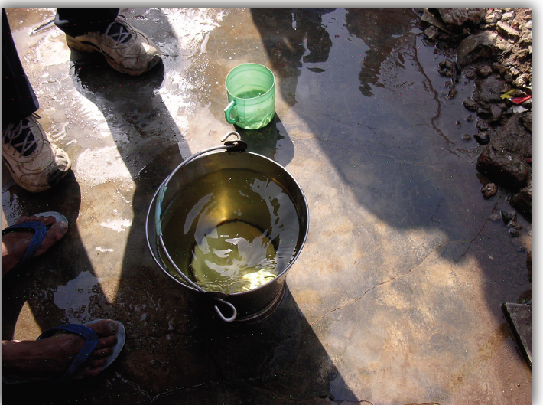
Directions regarding domestic HW
(vii): Supply of water to communities affected by ground water contamination due to HW
Faced with the problem of contaminated GW from industrial wastes in Gujarat and MP, the SCMC requested SC to direct the supply of water to the affected communities before the summer of 2004
SC accepted the plea and issued order on 7th May, 2004
In Gujarat , the order was complied for 26 villages at a cost of Rs. 5.5 Cr.
For Bhopal water supply was 40 MLD in affected area around UCIL.

Slide 32
Directions regarding domestic HW
(viii): Waste minimization
As per HW Rules amended in 2003, SPCBs have been given power to demand proof of waste reduction efforts at the time of grant or renewal of authorization
SCMC was not able to evaluate the impact of this amendment largely because it was too recent and majority of units had already been granted authorization for a period ranging from 3-5 years.

Slide 33
Directions regarding domestic HW
(ix): Policy document on HW and landfills
Policy document covering both issues was prepared by the CPCB and circulated in SCMC for comments
Draft sent to MoEF.
Policy does not take into consideration the widespread opposition to the location or siting of landfills for HW

Slide 34
Directions regarding domestic HW:
(x): Latest cleaner technologies
The CPCB was directed to bring the latest cleaner technologies to the notice of SPCBs/PCCs and to require the said Boards/Committees to ensure compliance thereof within six months.
CPCB has done good work and complied in respect of recycling /reuse of used oil/waste oil and non-ferrous metals.

Slide 35
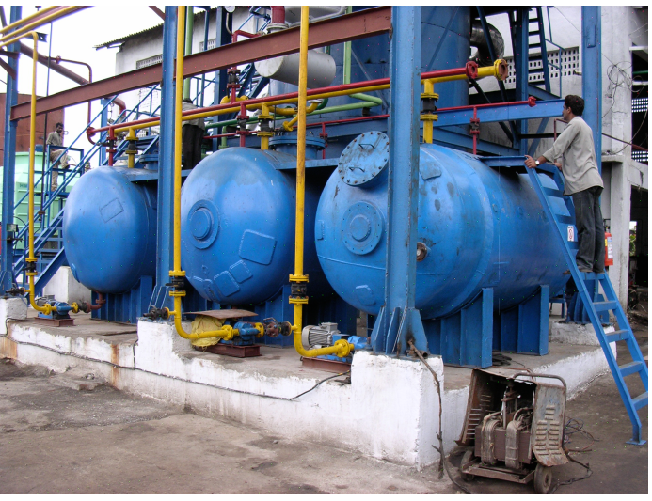
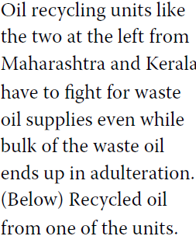
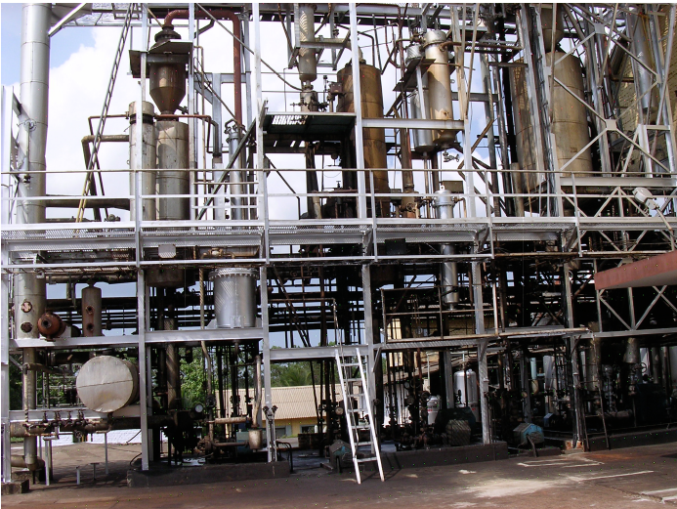
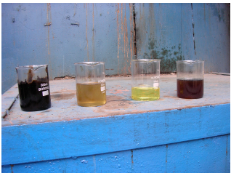
Directions regarding domestic HW:
(xi): Waste oil transport and waste oil trade
The waste oil trade is worse today than when the order dated 14.10.2003 was passed.
Since the issue is indeed very serious, a separate report on it was filed in August, 2007 by Dr. Boralkar and Dr. Claude Alvares for consideration of the SC.

Slide 36
Directions regarding domestic HW:
(xii): Implementation of rules relating to plastics and batteries
SCMC, among other things, recommended minimum thickness of 40 micron for plastic bags and suggested vital role for local bodies in its implementation.
SCMC was convinced that serious efforts have ben made by some of the SPCBs
Scenario is chaotic from the point of view of large scale illegal imports
Used batteries (LABs) find way to kabadiwalls.
More work is required for the application of EST and ESM

Slide 37
Directions regarding domestic HW:
(xiii): Implementation of check-lists by SPCBs/PCCs
The CPCB was directed to prepare and issue a check list to be used diligently by officers of SPCBs/PCCs before the issue of authorization letters under the HW Rules.
CPCB has sent the check lists to SPCBs/PCCs but SCMC found that second part of the direction not implemented.
It is amazing that even now there is no uniformity. Matter is left to the individual talent of the Boards with the consequence extremely poorly drafted authorizations continue to be issued.

Slide 38
Directions regarding domestic HW:
(xiv): Upgrading the laboratories at ports & customs
Rs. 5.1275 have ben spent to upgrade Customs laboratories at Chennai, Delhi, Kolkata and Kandla.
Instruments procured additionally are :
  TCLP agitator, Zero
  Zero Head Extractor
  Karl Fisher titrator,
  pH and conductivity meter
  Elemental analyzer
  Hydride vapor generator
  Hollow cathode lamps
  Microwave digester
  Bomb calorimeter
  TOC Analyzer
  Ion selective electrode
  UV Visible spectrometer
  AOx analyzer

Slide 39
Directions regarding domestic HW:
(xv): Institutional reforms: Strengthening of Pollution Control Boards/PCCs/MoEF/CPCB
SCMC did not receive any proposal or report regarding institutional reform being carried out at MoEF and CPCB. Similar is case for most of the SPCBs
Some Boards created few more posts without much reformation in the organizational structure and function
Most of the State Boards continue to be headed by non-specialists which is in violation of SC order.

Slide 40
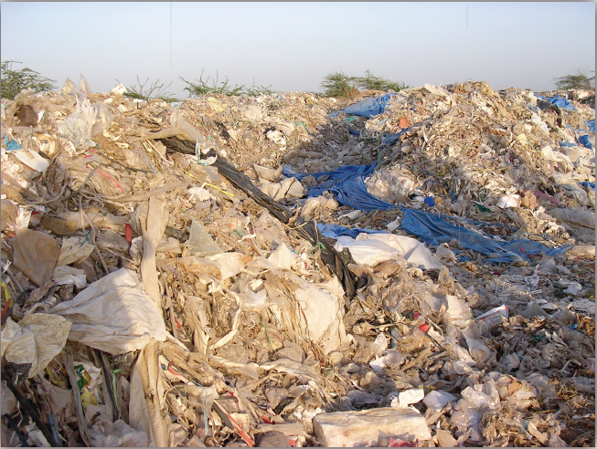
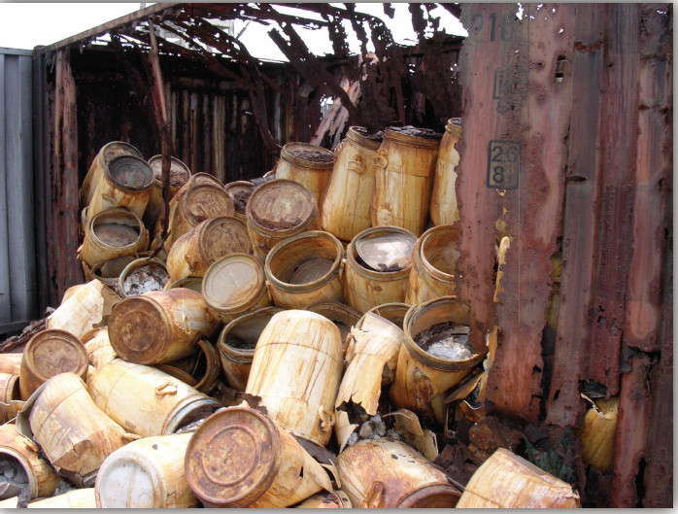
Directions regarding Imported HW & Basel Convention:
(i): Additional controls to prevent imports of HW
SCMC was unable to pay adequate attention to the situation and to assist authorities with ways and means to halt imports
India still remains a destination for dumping of waste oil, varieties of plastic waste, metal scraps, clinical & municipal wastes, discarded building materials, used cloths, waste paper and empty pet bottles
After Court order, the situation was altered somewhat though the almost scandalous & open imports continued
Plastic waste at Kandla
Hazardous chemicals at JNPT

Slide 41
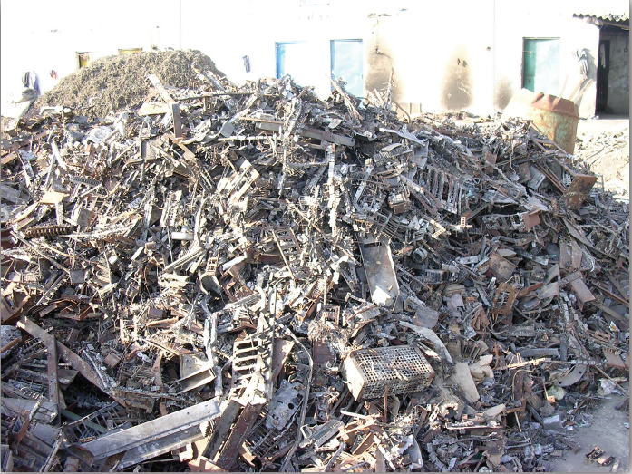
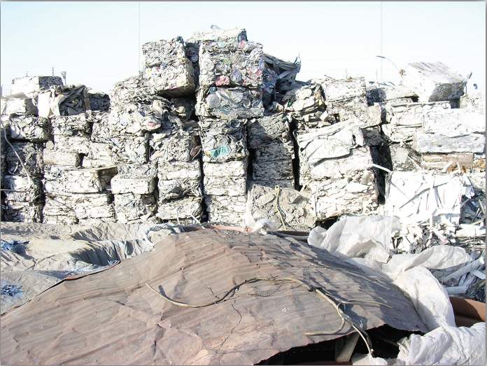
Directions regarding Imported HW & Basel Convention:
(i): Additional controls to prevent imports of HW
Piles of metal scraps and compacted plastic waste found to be imported at SEZ, Kandla. The importers did not have authorizations

Slide 42
Directions regarding Imported HW & Basel Convention:
(i): Additional controls to prevent imports of HW
Large quantities of waste / used oil coming through ports like JNPT and Cochin under the garb of RPO and other nomenclatures
Consignments are priced extremely low and move from country to country and often picked up from high sea by Indian importers
These are then allegedly used for adulteration under the cover of recycling
ICD Ahmedabad impounded 106.4 MT of waste oil in August 2006
Wastes lead acid batteries were found illegally imported through Cochin Port
E-waste is the new illegally import flooding this country. The SC directed CPCB to make random checks.
No inventories of waste imported
Amendments in Custom Act and changes in EXIM Policy required

Slide 43
Directions regarding Imported HW & Basel Convention:
(ii): Disposal of HW impounded at Ports and ICDs
Consignments of waste oils lying at Tuticorin incinerated under TNPCB
HW at ICD Bangalore sent to TSDF after solidification
47 containers of waste oil at MbPT incinerated at TSDF Taloja
DPCC in association with CPCB was asked to verify HW lying at ICD Tuglakhabad and decide disposal options
Punjab PCB in association with CPCB was asked to verify and decide in respect HW lying at Ludhiana ICD
Commissioner of Customs, Mumbai was asked to verify and confirm the quantity of HW lying in JNPT and then decide disposal options in consultation with MPCB

Slide 44
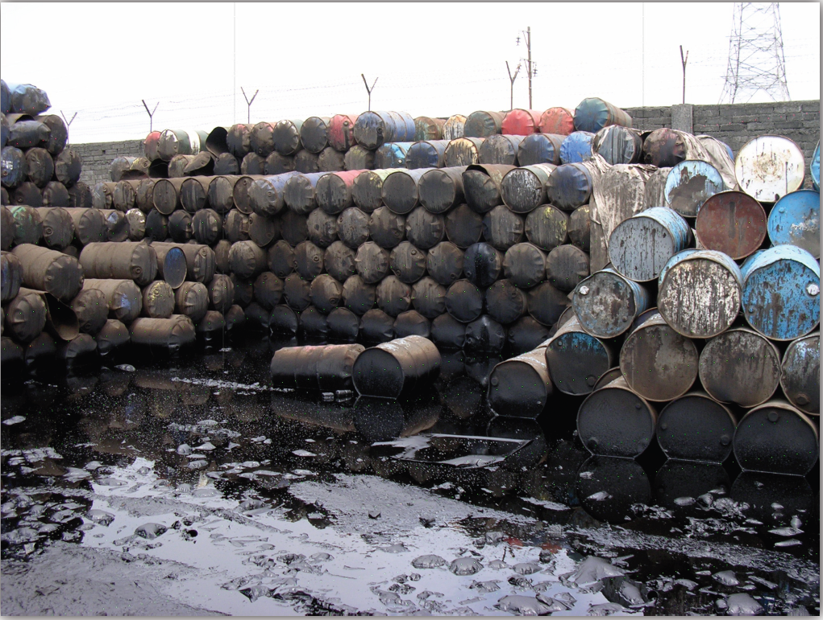
Directions regarding Imported HW & Basel Convention:
(iii): Destruction by Incineration of 133 containers of waste oil illegally imported at JNPT ( SC Order dated 5.01.2005)
133 Containers moved to TSDF Taloja
SCMC sub-committee supervised
MPCB ensured that incineration followed norms
Cost of incineration Rs. 2.86 Cr. Paid by Customs

Slide 45
Directions regarding Imported HW & Basel Convention:
(iv): Directions relating to Dirty Technology Import
CPCB was directed to do research and to take up the matter with MoEF for requisite regulatory measures in regard to the import of dirty technologies into the country
SCMC is not satisfied with the routinely submitted information by CPCB relating to meetings, papers, etc as fulfillment of the directions

Slide 46
Directions relating to further amendments to existing laws and statues:
Amendments to HW Rules, 89
MoEF complied
Ministry of Labour and Ministry of Industry was asked to set up special Committee to examine the problems of workers in HW units in terms of their occupational hazards, health and compensation. This was complied.
Recommendations of the Special Committee not implemented by authorities
Nether have any provisions being incorporated in the amendments of HW Rules even though this was specifically requested by the Special Committee

Slide 47
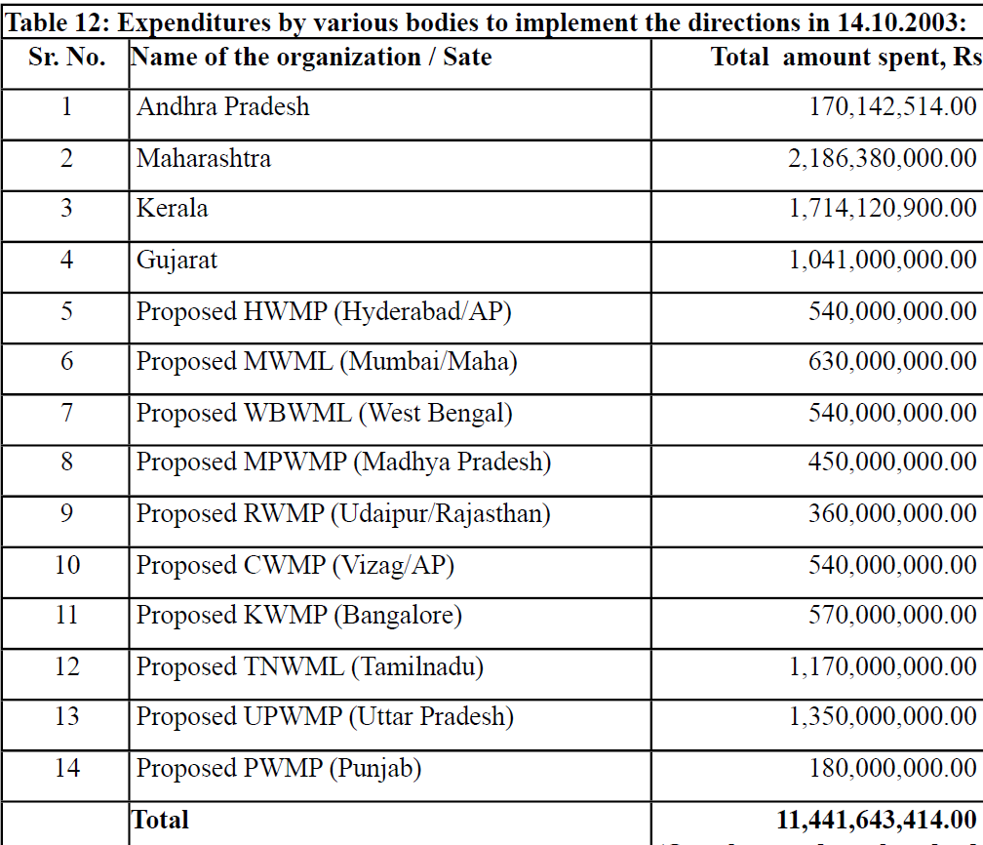
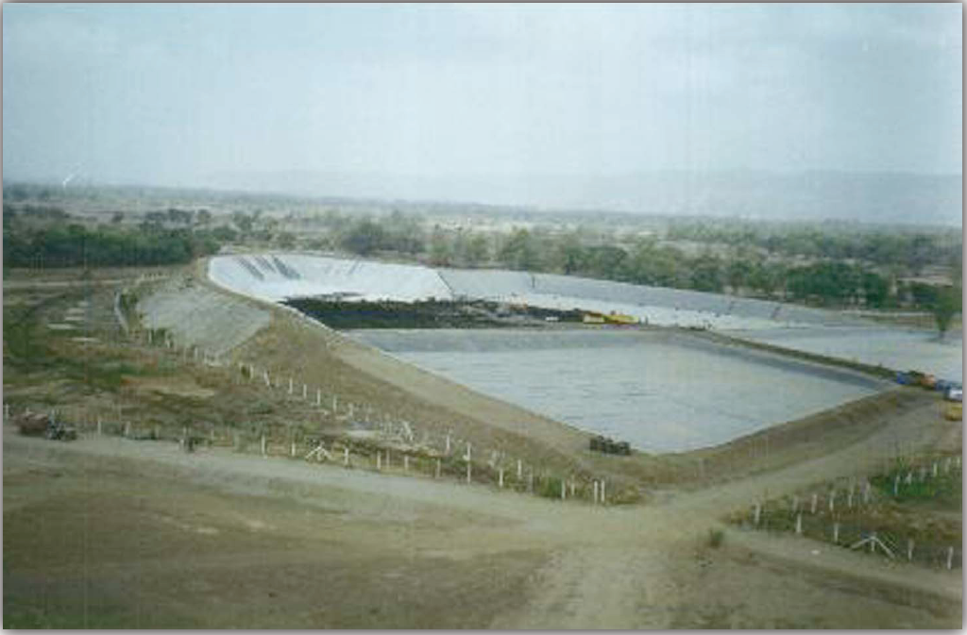
Costs of implementing SC Order as received from AP, Maharashtra, Kerala, Gujarat & Other States:
Rs. 1144 Cr. spent by various bodies in carrying out the various directions and committed for approved projects pursuant to the order

Slide 48
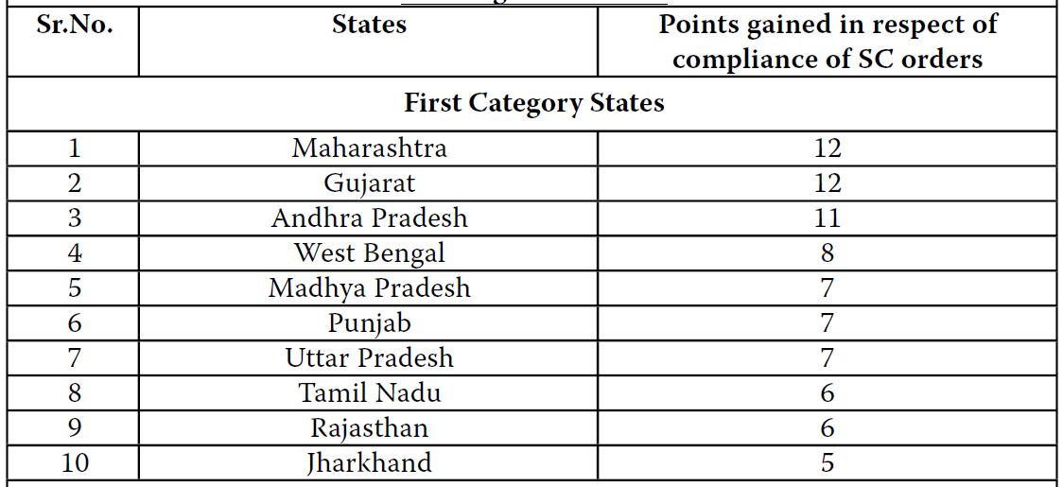
Performance Index of Various States in Implementing the Court’s Directions : Rating of the States

Slide 49
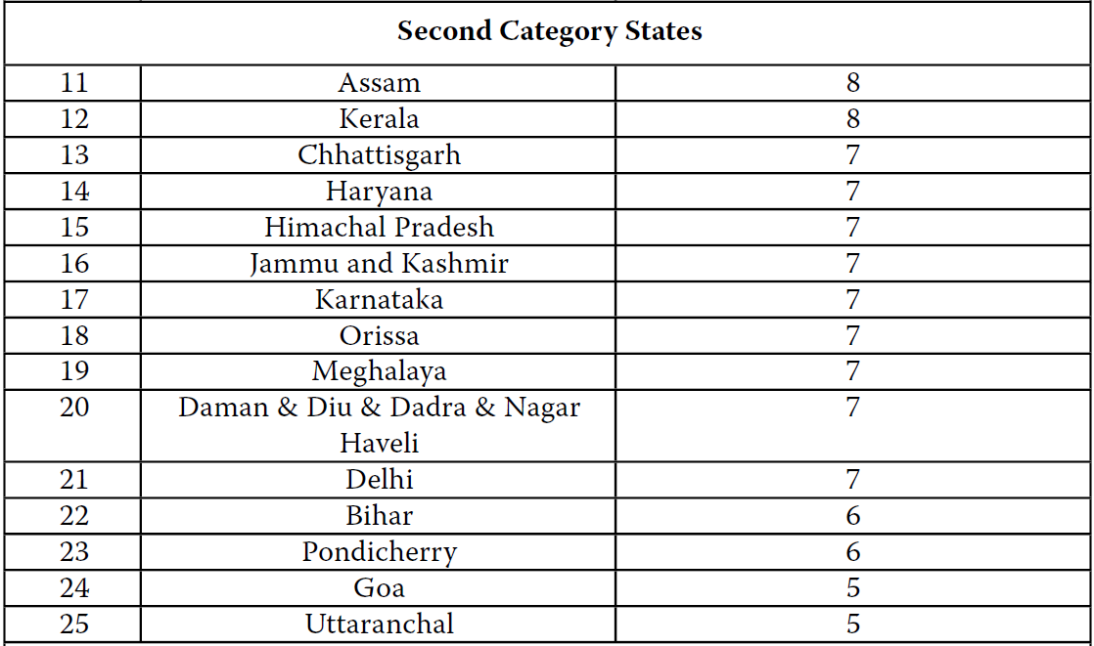
Performance Index of Various States in Implementing the Court’s Directions : Rating of the States

Slide 50
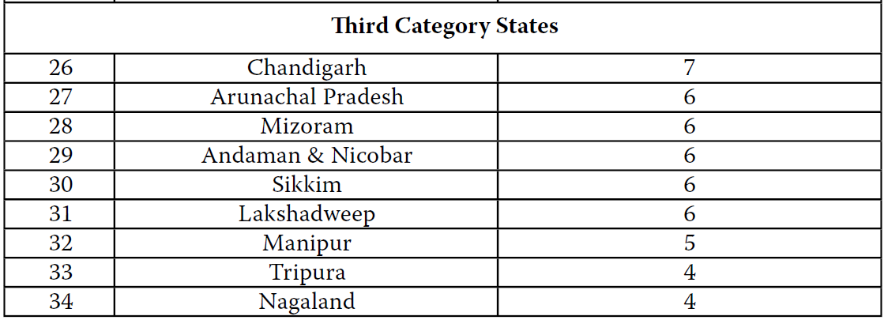
Performance Index of Various States in Implementing the Court’s Directions : Rating of the States

Slide 51
Conclusion
Achievable vision for effective & total management of HW
The SC Order dated 14.10.2003 has not disposed of the petition
The Court was aware that the problems relating to HWM within the country were quite complex
There were several problems still to be resolved with regard to import of HW

Slide 52
Conclusion
Achievable vision for effective & total management of HW
Considering the gravity of the scenario depicted by the Menon Committee the Court passed a comprehensive order keeping a holistic picture in view which required authorities concerned to :
  Finalize the data available on HW generation within the country and have it posted on public media
  Ensure clean up of illegal HW dumps
  Ensure that conventional scientific solutions like SLF and incinerators are installed and operated as per norms
  Prepare policy on HW and landfills which assume reduction in generation of HW including wastes from abroad
  Ensure citizen’s and community participation in HWM

Slide 53
Conclusion
Achievable vision for effective & total management of HW
The Court came to conclusion that the most important authorities in the scheme of things were the SPCBs which had to be strengthened considerably in terms of adequate and qualified manpower and infrastructure. SCMC was set up to ensure that the systems for this scheme were up and running.
The picture that emerges from this report is not satisfactory
Outstanding and impressive work has been done by few players, but many are still far behind

Slide 54
Conclusion
Achievable vision for effective & total management of HW
Successful Sates ( Gujarat, Maharashtra, AP) have demonstrated that it is possible to implement Court directions and to establish HWM system that minimizes harm to ecology.
Resources are not the problem, as the major assets (TSDF) are created out of the demands of the Polluter Pays Principle
IT tools can be intelligently and wisely used for better planning and management of HW

Slide 55
Thanks very much!

